Slide 1

Sensor Kit (Kit 1)
ZAS Robotics Training

Slide 2



Sensor Kit - Contents
Sensor Kit Components
Sensor Creative Board

Slide 3



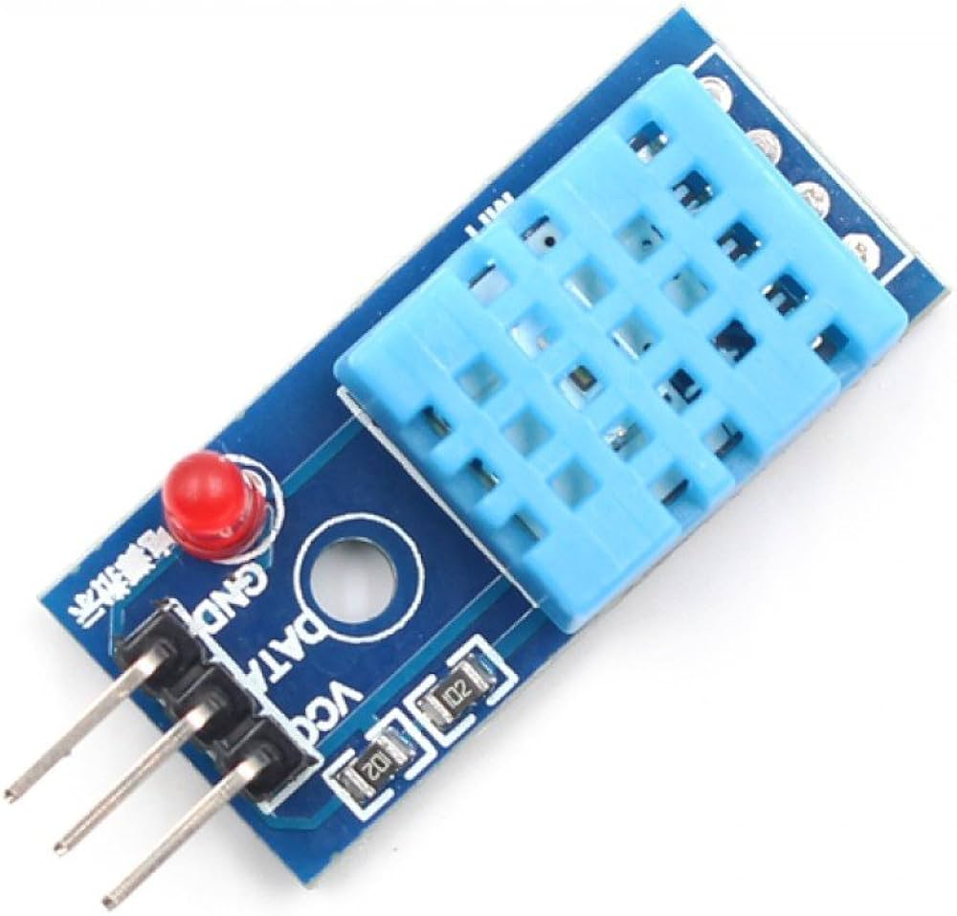

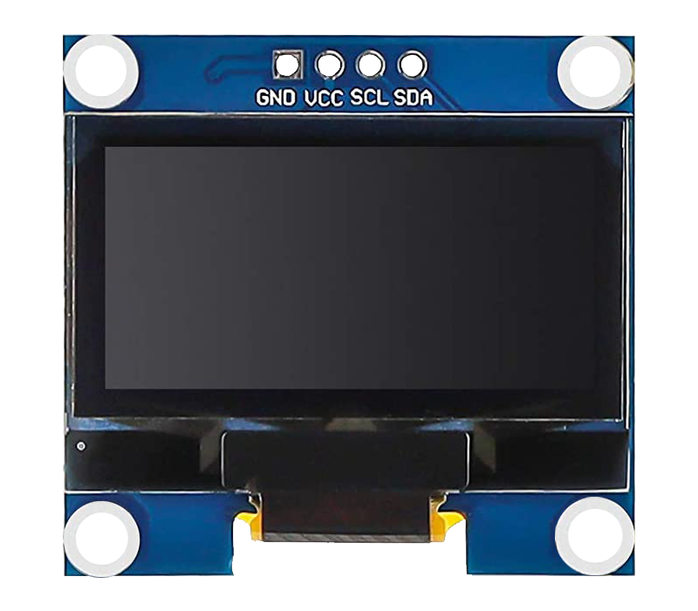
SFL11: TEMPERATURE AND HUMIDITY (DHT) SENSOR WITH OLED
Things Needed

Slide 4
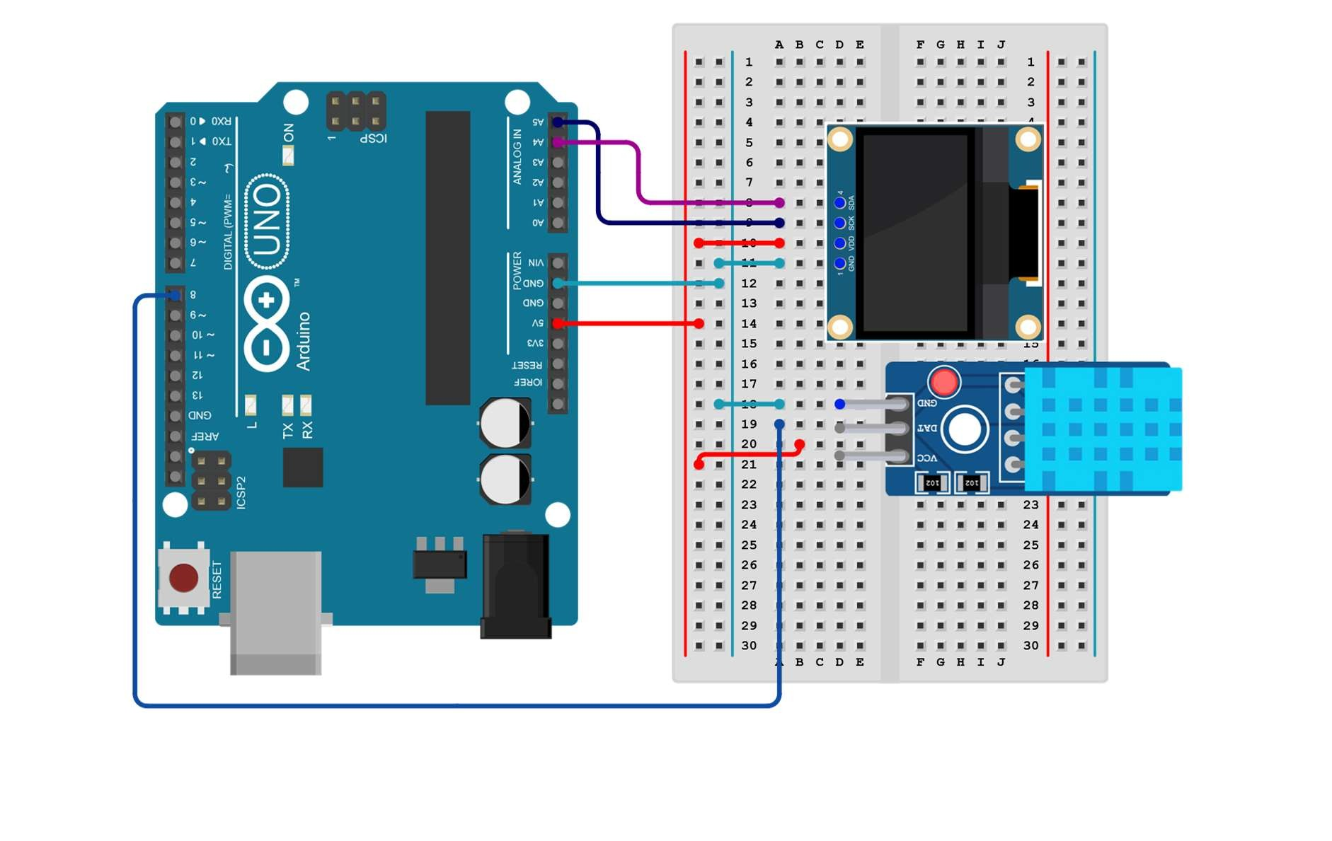
SFL11: TEMPERATURE AND HUMIDITY (DHT) SENSOR WITH OLED
Connections:
Arduino pins | breadboard
5V | VCC(red)
GND | GND(light blue)
Pin 8 | DATAS

Slide 5
SFL11: TEMPERATURE AND HUMIDITY (DHT) SENSOR WITH OLED
🔧 SETUP() – runs once
Starts Serial Monitor communication: Serial.begin(9600)
Initializes the DHT11 sensor
🔁 LOOP() – repeats forever
Waits 2 seconds between readings
Reads temperature and humidity
Checks whether the sensor reading failed
If successful, prints:
  Temperature in °C
  Humidity in %
Code for the Lesson SFL11:
https://github.com/info-zas/zas-robotics-sensors/blob/main/01_FoundationProjects/01_Code/_12_MeasuringTempAndHumidityWithDHT11OnOLED/_11_MeasuringTempAndHumidityWithDHT11OnOLED.ino

Slide 6
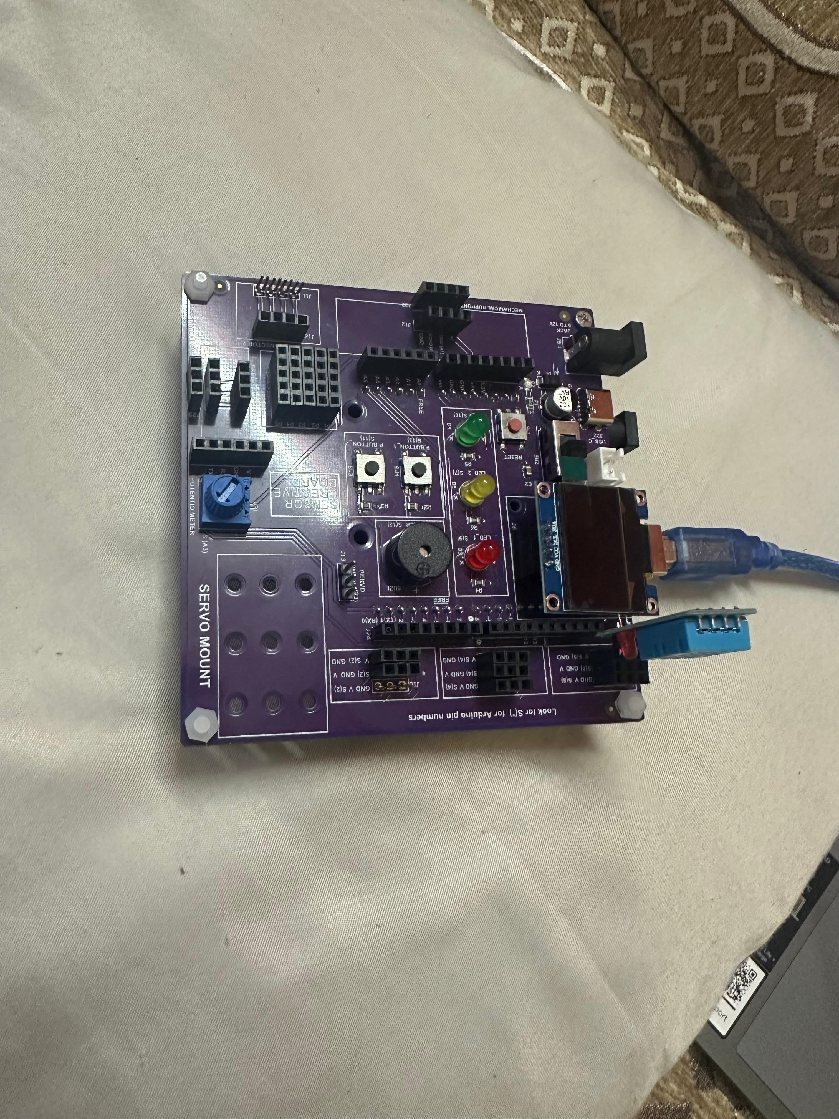
SFL11: TEMPERATURE AND HUMIDITY (DHT) SENSOR WITH OLED

Slide 7
SFL11: TEMPERATURE AND HUMIDITY (DHT) SENSOR WITH OLED

